Slide 1
From the wilderness, to the mainstream, and beyond…
Dave Jarman

Slide 2
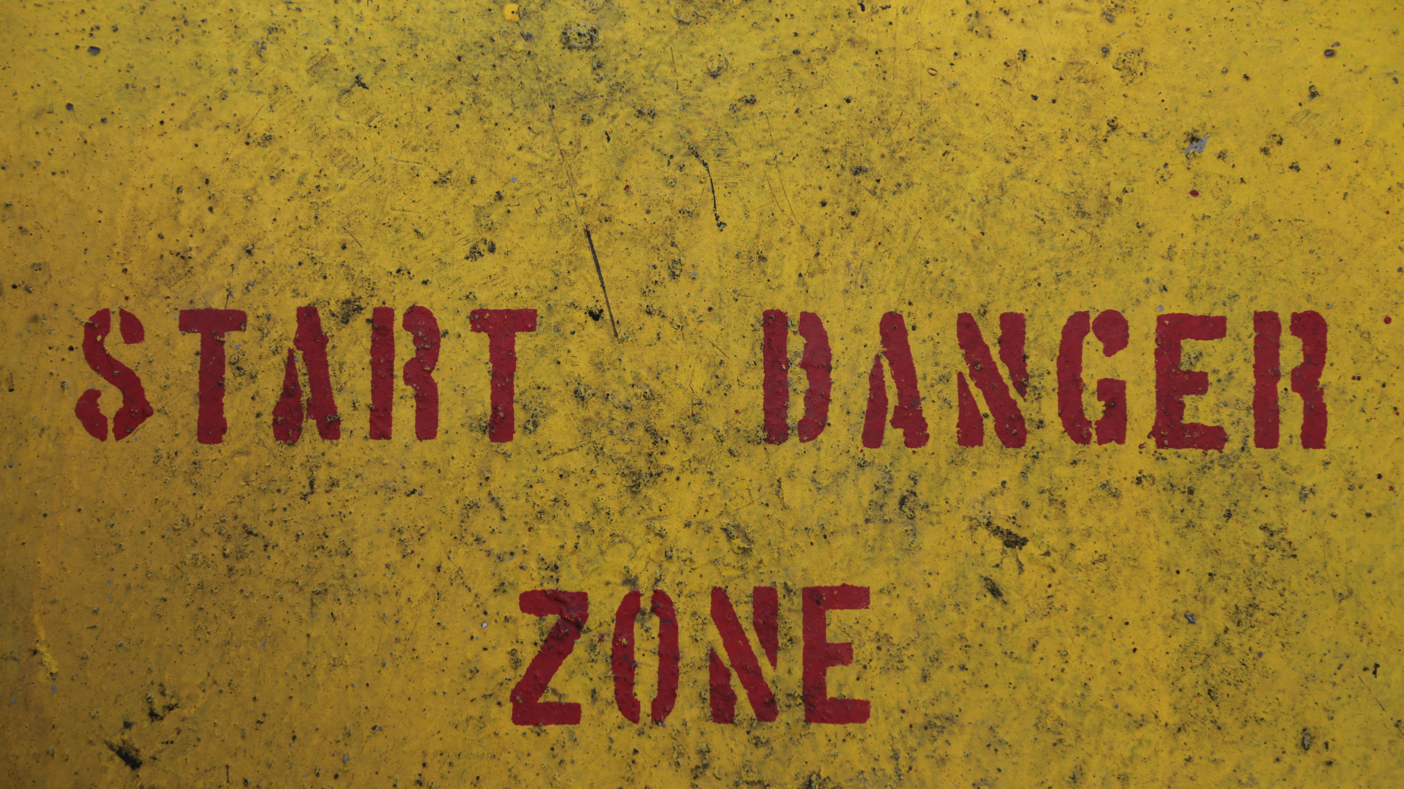
Warning!
Ideas under construction.
Avoid low-flying unattached philosophical musings.
Photo by Bernd 📷 Dittrich on Unsplash
Notes:
A quick health warning…

Slide 3
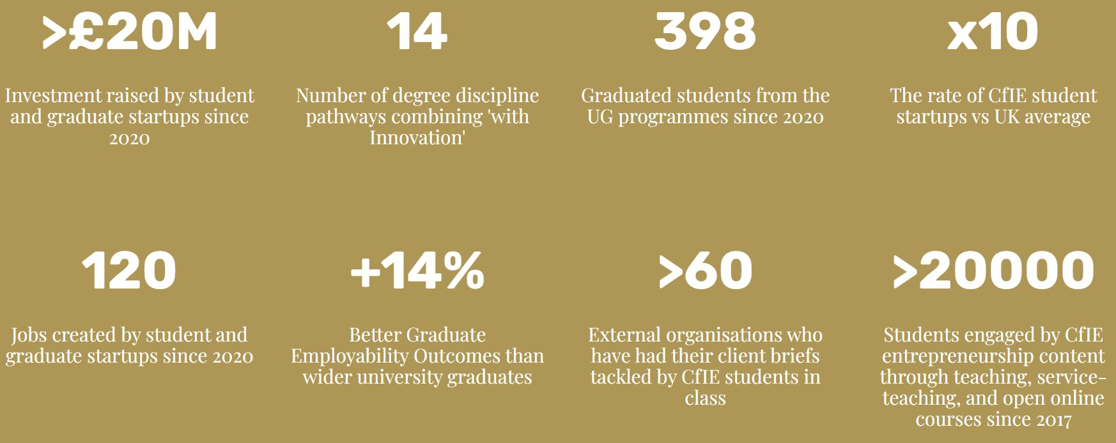
WWW.BRISTOL.AC.UK/INNOVATION
Notes:
I’m not going to specifically talk about what we do at Bristol – but we like to think its pretty good – look us up. We can talk later.

Slide 4
The true face of disruption…

Slide 5
You’re not ready for this.

Slide 6
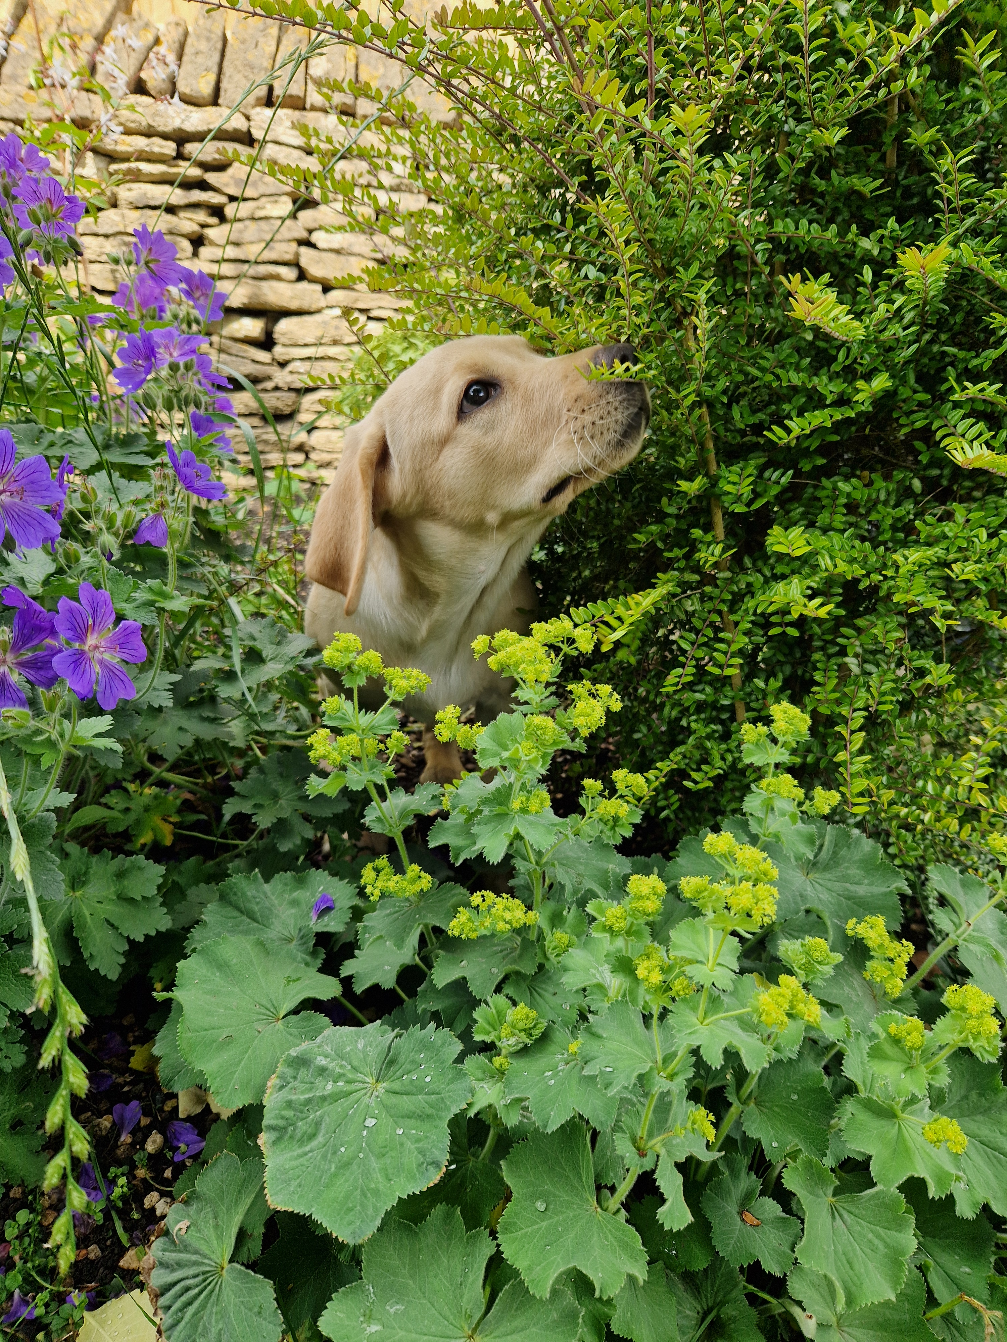
Notes:
Her name is Blossom.
Yeah she looks cute – but she is a NIGHTMARE.
Shortly after this photo she dug those flowers up and almost escaped the garden…

Slide 7
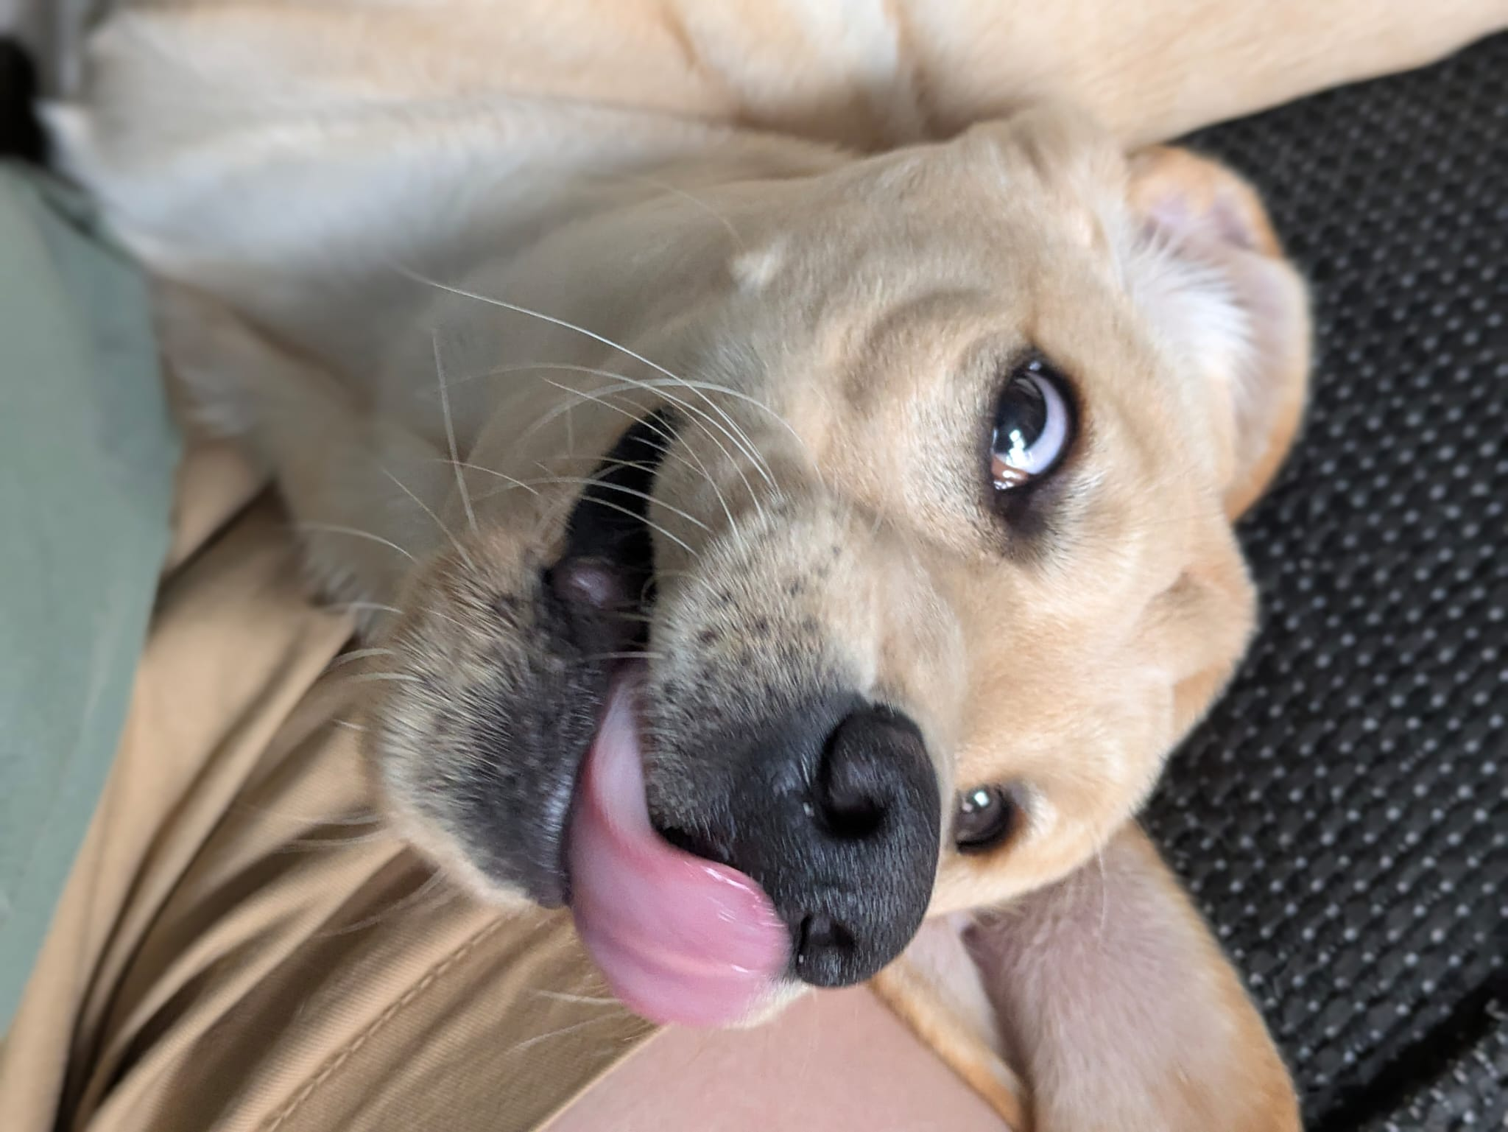
Notes:
She has stolen shoes, chewed furniture, nibbled fingers, headbutted children, torn clothes, kept us awake at night, stopped us travelling overseas, covered us in blonde hair, shattered our routines…disrupted our lives and our relationships! Is she worth the disruption?

Slide 8

DISRUPTION
Disruptions can take a lot of different forms.
Most of them set by how we react to them.
A Derailment
A Barrier
An Obstacle
A Detour
A Speed-Bump
A Pause
A Change in Perspective
An Opportunity
‘Creative Destruction’
Photo by Ben Wicks on Unsplash

Slide 9
This keynote:
A journey through past present and future disruptions.
Notes:
That was all merely a preamble!
In this particular tale, I’m using my particular journey at the University of Bristol, at Bath Spa University, and tales told to me by national colleagues to describe a journey through and to disruptions.
Other institutions were on adjacent timelines – some travelling faster, some slower, but I hope the trajectory is familiar!

Slide 10

The past: we were once mavericks.
Pioneers in the wilderness.
We were the disruptors.
We started-up.
Photo by Veerle Contant on Unsplash
Notes:
Ent Ed were the upstarts! We were going to shake up the institutions!
There’s no room in the curriculum for commerciality said the academics – even in the Business School they drew the line at practicality.
The Business Schools thought we were marginal cases.
The Careers Services said only a tiny number of students started-up so why bother. Careers was still a doctor-patient relationship and embedding employability was a radical idea, enterprise skills were a still-more radical concept.
Commercialisation income was nice-to-have.

Slide 11
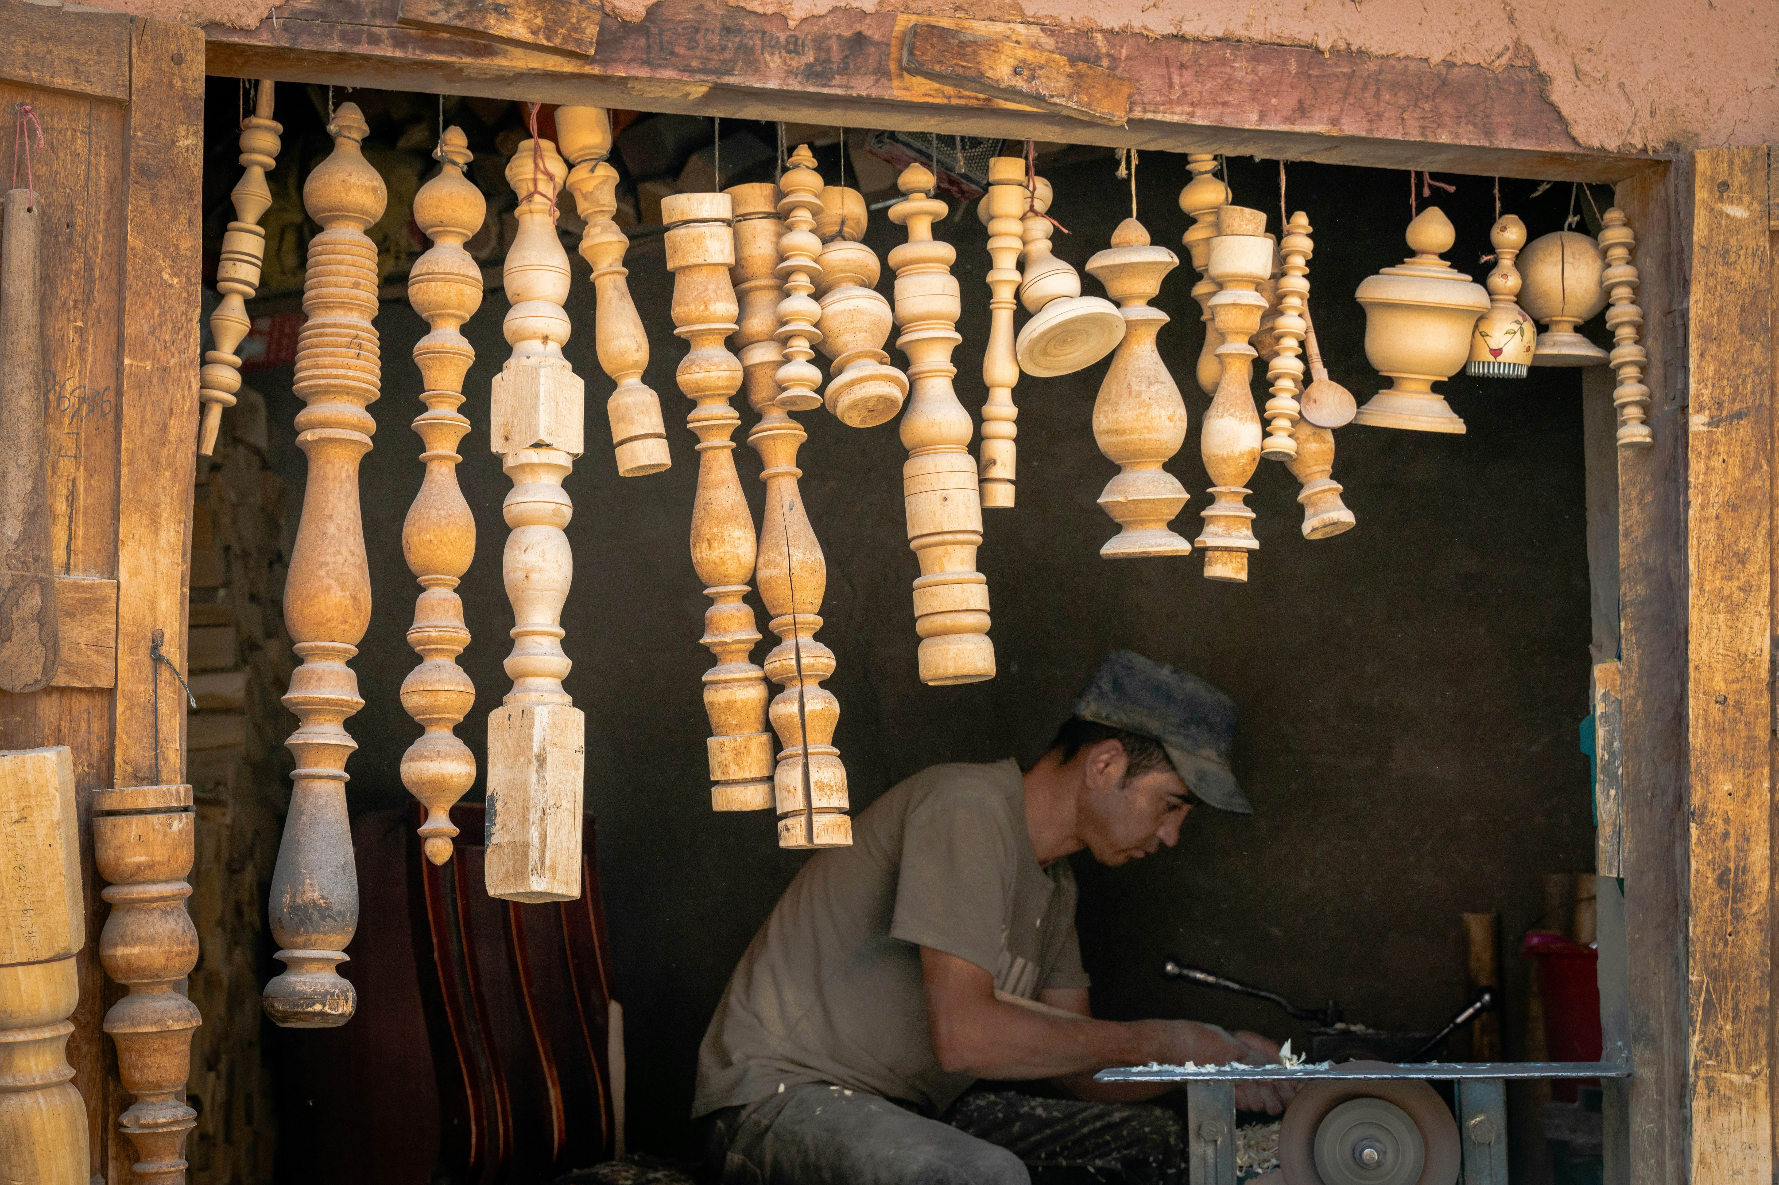
The past:
“artisans in the workshop.”
Photo by Austin on Unsplash
Notes:
We were small insurgent teams, working on the periphery, scrapping for attention and resource and making the best of it.
Enterprise, Entrepreneurship, Innovation, Impact – these were all slippery terms – which was to our advantage, we could be agile. Whilst we craved more attention and resource we could also wing it without challenge.

Slide 12

Musk rising:
Elon musk. Tech BRO hero.
Getty Images
Notes:
Tech for good – lets build electric cars and go to space!
The robots were coming for the manual labourers – not our problem!

Slide 13
The present: scaling through crises
From disruptors to disrupted.
Burnout.
Photo by Mick Haupt on Unsplash
Notes:
We’ve grown up – we not pioneers in the wilderness any more – we’ve arrived and were scaling.
Some of that scale in the sector has just lurched into crisis and we’re finding out just how robust we may or may not be.
My under-researched hot-take on the current crisis would be that where EntEd is embedded in curriculum it is likely to survive, co-curricular offerings may be in more danger, but even where we survive, we’re likely to be doing more with less…
And this is all set against a general sense of crisis – sector turmoil, politics, Trumpism, Ukraine, Gaza… and holy shit, the AI is coming for US?! We thought it was coming for the guys in factories?!
Now we have to adapt ourselves, learn new ways and means – do our existing strategies even scale?
Employability has swallowed Careers and there is an expectation that courses support employability… but who is delivering that – careers people (are there enough of them?) academics (do they know how to do that?) or us – the maverick straddlers of the academic/professional territory? Our slipperiness is back to bite us.
Are we potentially part of the response to ‘everything’ – do our maverick methods even work at scale? Emily Beaumont and others have written about this!
Are we burning out by trying to teach, and create start-ups, and support KE and impact? (let alone do research). Because our universities can and will ask practical academics and resourceful professionals to do this stuff… As Martin Lackeus whispered to me in Munich – “legal institutions won’t love you back”

Slide 14
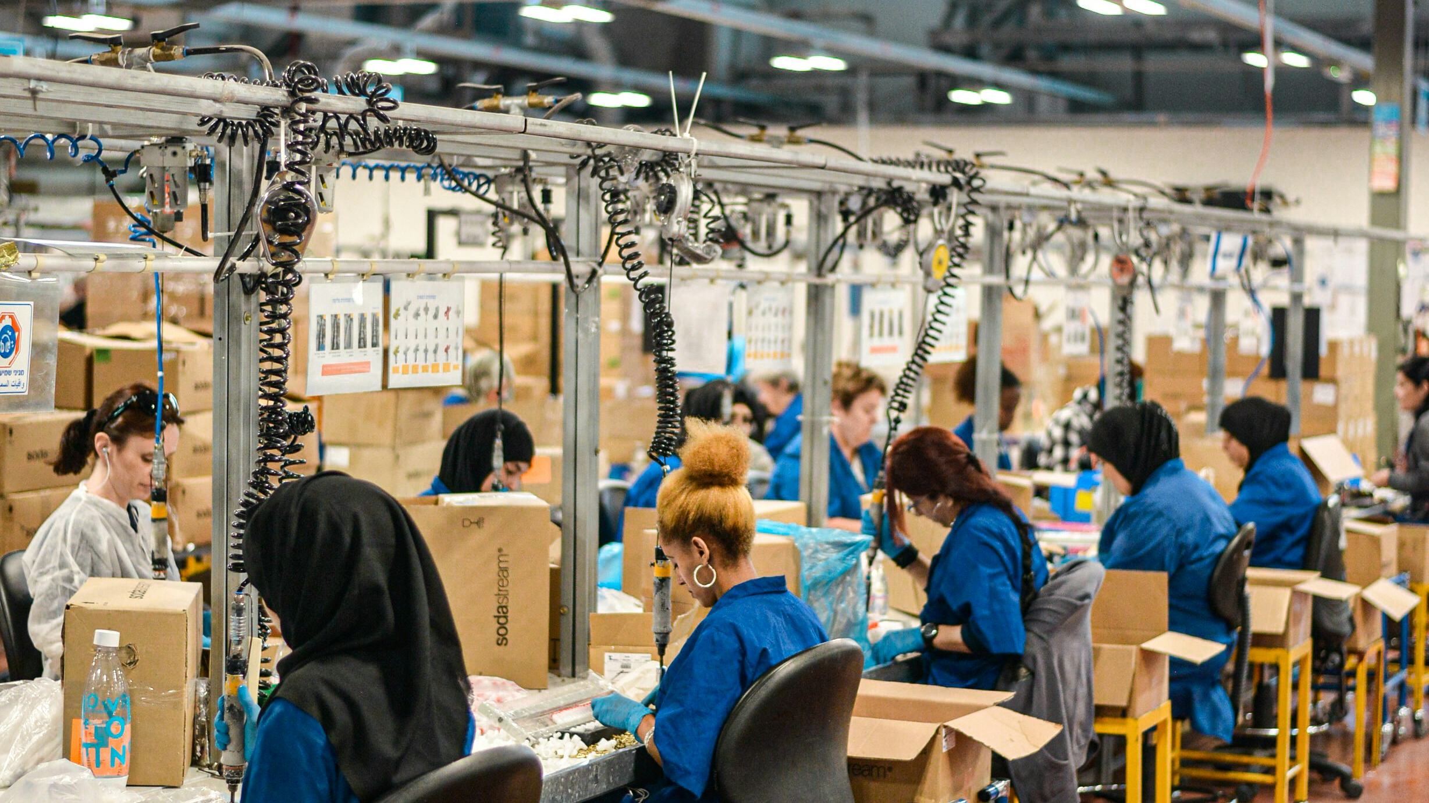
The present:
“technicians on the production line.”
Photo by Remy Gieling on Unsplash
Notes:
Is there a university that does not have enterprise or entrepreneurship in its mission and vision?
There are at least 4 factions at Bristol fighting for ownership of Entrepreneurship at the Institution!
Are we the mainstream now?
How far can we scale before we lose something critical to the experience of Ent Ed?
Have we become ‘diluted’?
By creating something scalably consistent have we opened the door to being replaced too easily?
Or are we seeing the beginnings of fragmentation? Because there are more of us, we’ve been able to specialise – and maybe fragment?

Slide 15
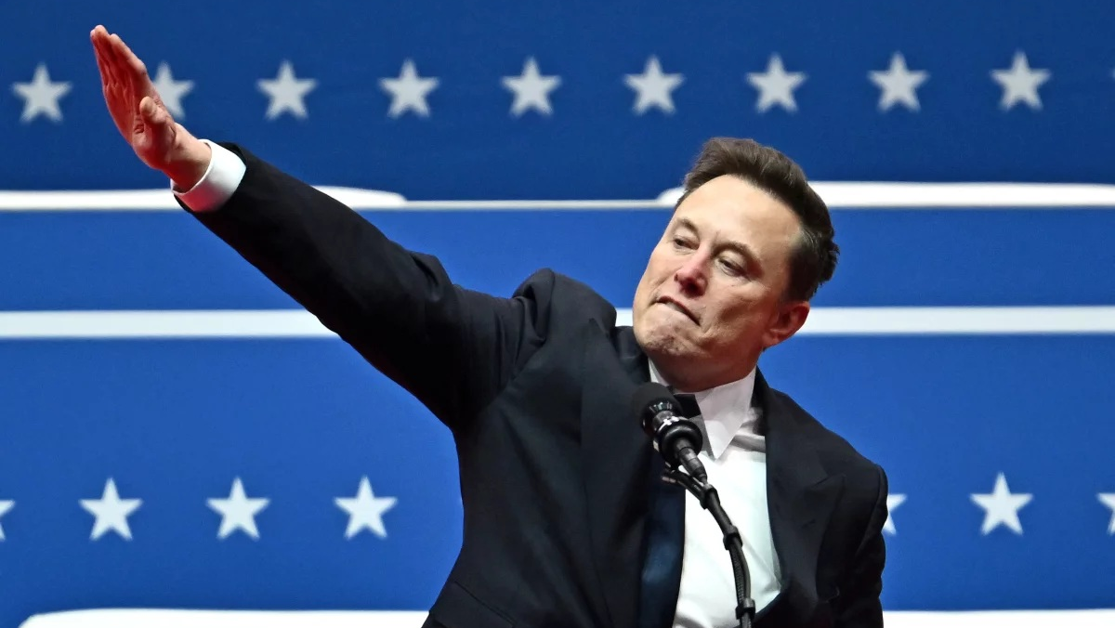
Musk falling:
Elon musk. SuperVillain.
Angela Weiss via Getty Images
Notes:
I mean this guy. He’s fallen a LONG way – but he’s also the same guy – he’s still as disruptive but now he’s disrupting things we liked! Kelly Smith and the IEEC hashtag used to take over Twitter for 3 days – not so much any more…
Maybe we need to acknowledge that disruptive behaviour provokes different reactions in different people at different times…
We might also wonder how and why Musk is so disruptive? If you’ve delved into his upbringing it’s hard not to see how adversity has shaped him for better and worse.
There’s an interesting study in multi-medal elite athletes and how they’re different to other ‘good’ athletes – and adversity and trauma play a role in shaping that unrelenting drive – it makes me wonder how much adversity is good adversity? Is there a right level of friction?

Slide 16

The future:
It’s already Here. but “unevenly distributed” (William Gibson)
Photo by Werner Du plessis on Unsplash
Notes:
And so to the future – but its already here for some of us.
Some of my past might look like the present to some others in this room. Some of my present might look like the past to some of you.
As an NEEA judge for many years I know that many institutions are just building some of things that others of us built 15 years ago – whilst others are moving in directions we might never have predicted.

Slide 17
WEAK SIGNALS OF THE FUTURE
From Sustainability to Restorative and Regenerative Entrepreneurship.
But… “This isn’t my fault – it’s grandad’s fault…”
…and “I’d actually just like to make some money first.”
The Polycrisis provokes Fight, Flight, and Freeze responses.
Rejecting the Hustle. Rejecting ‘Entrepreneurship’.
But the methods and mindsets gain acceptance.
Notes:
So, whilst we can’t predict the future, we might divine some potential futures from the signals we see today:
1 – whilst we’ve been trying to make our curriculum more regenerative, because we thought students would respond to that – we’ve actually had pushback – students crowding on commercial projects and spurning the greener options!
The polycrisis is overpowering – It’s challenging to choose to Fight, Freezing or Fleeing seem like tempting options!
2 – we’re also getting a handful of students rejecting both ‘hustle culture’, which I personally think is quite wise, but also rejecting the name ‘entrepreneur’ – for a variety of reasons but largely THIS GUY again. They’re ok with much of the process and method, but the association with Musk and Silicon Valley is putting as many off as its attracting.

Slide 18
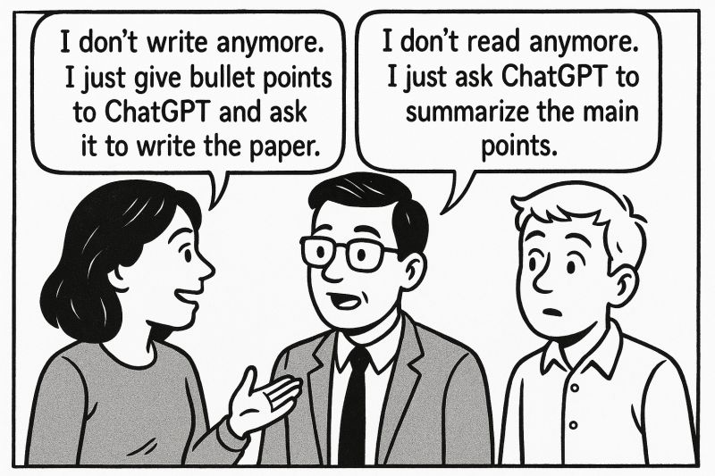
WEAK SIGNALS OF THE FUTURE
From Mainstream to Mandatory…
*Every* student studies EntEd
*Every* educator teaches EntEd
Dissertation becomes a pitch for an Institutional Equity Stake in student’s future income.
But WHICH BITS of EntEd become mainstream?
We all go home.
If they don’t need knowledge, what do they need? Skills? Context? Wisdom?!
Notes:
What if we won – what if we became not just mainstream but mandatory – where everyone has to learn it and everyone has to teach it? How do we feel about that?
Or, between students using AI to create the work and us using AI to mark it all we all just go home and have a lie down?
More seriously, if students have the world’s knowhow at their fingertips, they’re not coming to us for knowledge any more – they’re coming to us for something else – what is that and are we ready?

Slide 19
A BRIEF AI DIGRESSION
If a student is using AI to avoid unhelpful ‘grind’ for the sake of assessing – I’m fine with that.
What we do need to retain is ‘constructive friction’ – what activities actually help students learn?
Are students open to that friction? Are they expecting our provision to be as apparently convenient as A.I.?
Are we ‘derailing’ their expectations or offering a useful detour?

Slide 20
I think it's critical to discuss with our students what kind of futureS we actually want.
“the value of education must lie not only in its ability to equip people to earn money, but to make a world that is worth living in.”
Danny sriskandarajah, 2024

Slide 21
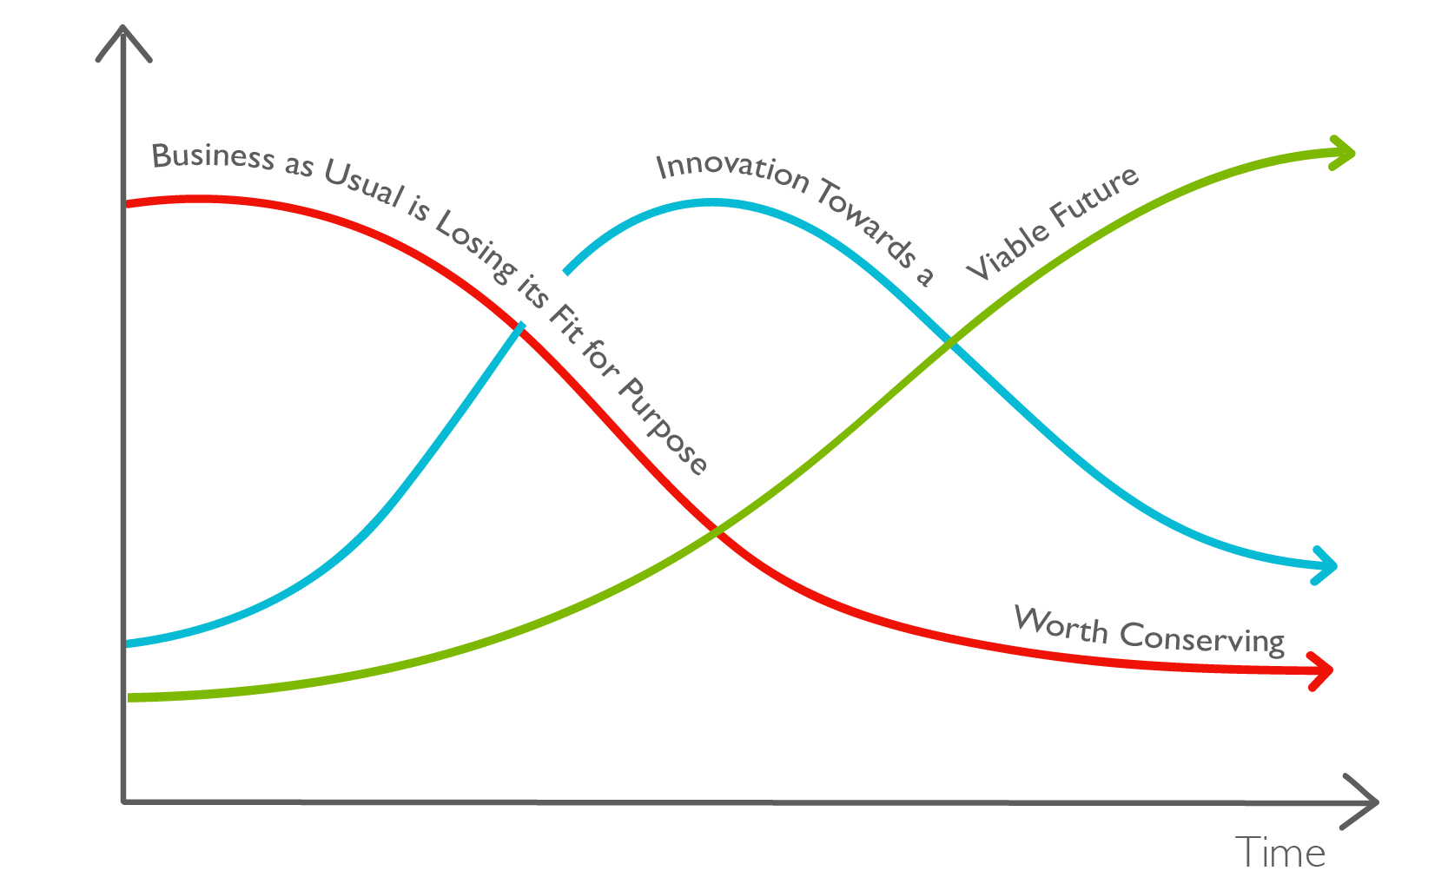
BILL SHARPE’S THREE HORIZONS
Notes:
We do the bit in the middle – it’s uncertain and ambiguous – we’re radical for H1 and not radical enough for H3 – we can get captured by H1!
I think there is a very human role for us in being there WITH our students through this uncertain space.

Slide 22
What comes ‘after’ ented?

Slide 23
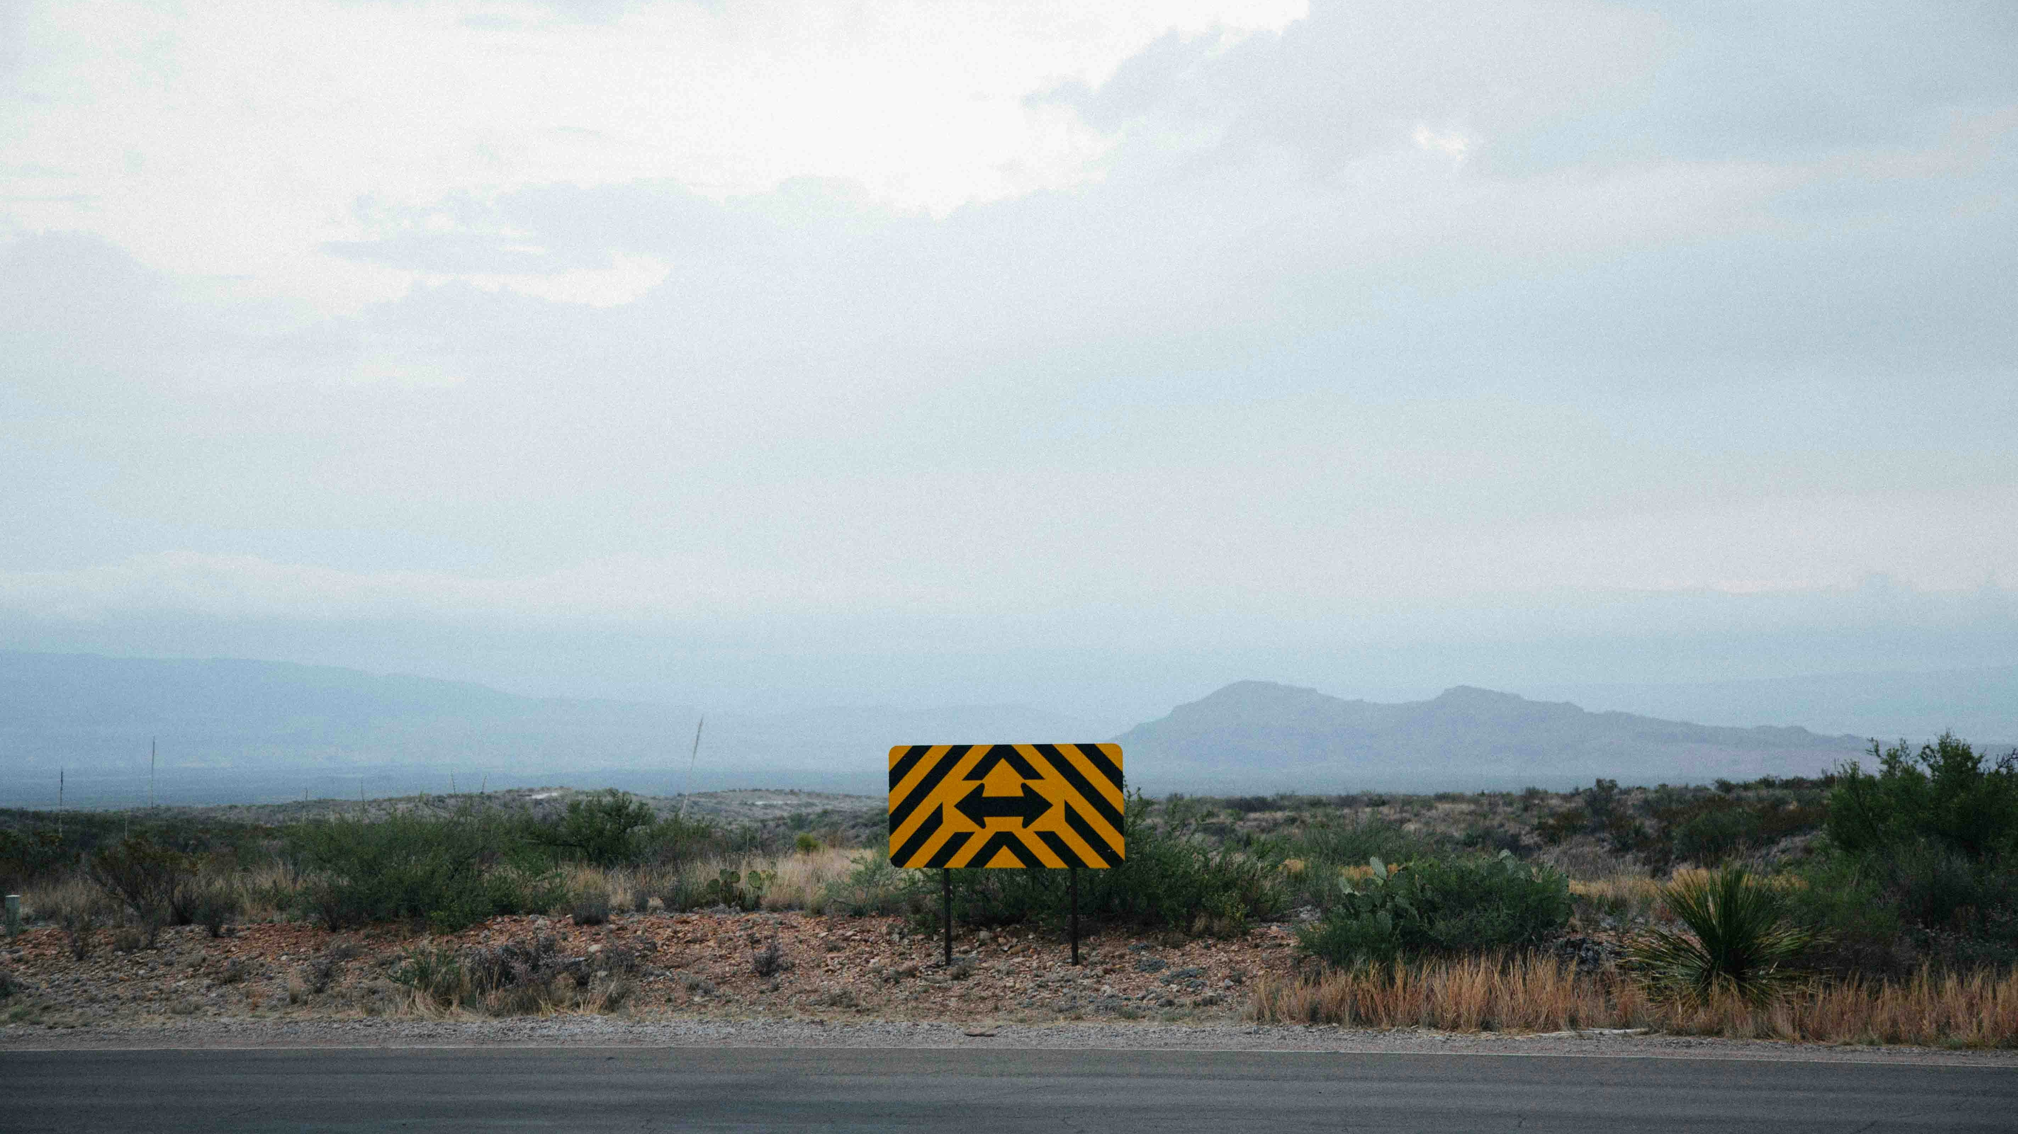
But what do I do about the future? worry
Get some perspectives.
Explore.
Hope.
Photo by Kyle Glenn on Unsplash

Slide 24

The future
“you don’t have a choice in being a role model – the only choice is whether to be a good one or a bad one.” (john Amaechi)
Photo by Marc-Olivier Jodoin on Unsplash
Notes:
Like it or not, we are setting examples to our students about how to approach the future – about how to deal with uncertainty and ambiguity. We have to offer HOPE.
So as we grapple with disruption we have a chance to integrate this into our teaching and coaching.
Our solutions might be clumsy, they might be iterative, they might fail – so lets make them quick and cheap!

Slide 25

“hope is not the same as optimism… optimism is a largely passive assumption… hope is different; it is the belief that things can change for the better, and the resolve to work towards that change.
(Danny sriskandarajah)
Photo by Faris Mohammed on Unsplash
Notes:
I think this is our emergent challenge – not just teaching entrepreneurial, enterprising, methods – but providing HOPE - a deeper, resonant, regenerative, purposeful means to judge where, when, and how to act entrepreneurially, and maybe when not to.

Slide 26
ented is uniquely placed to offer our students hope for the future.
“think like a system. Act like an entrepreneur.” (RSA) we have the means to understand we have the means to act we have the means to resonate.
Notes:
I always liked the RSA’s mantra of “think like a system, act like an entrepreneur”.
If you’re teaching systems thinking, design thinking, futures then you’re helping students to understand what is happening now and in the future – you’re helping them find places to get leverage on all kinds of challenges. You’re helping them engage with complexity and uncertainty and finds ways to navigate and anticipate.
If you’re teaching effectuation, problem solving, value creation then you’re helping them develop the competence and confidence to act.
If you’re helping them tackle the issues that they care about, if you’re helping them reach their aspirations and how to start their ideas up then you’re offering autonomy, mastery, and purpose – all of which will resonate.

Slide 27
Takeaway #1 ask “what might good look like?”
Notes:
When we’re exploring the future and developing new technologies and methodologies we should spare a thought about why and what happens afterwards. Maybe some of the broken things littering silicon valley should not have been broken in the pursuit of profit.
I’ve found this question useful for teaching – what does success in your degree look like? How will you judge the success of this proposed venture? And in my coaching and accelerator work – why is this idea worth making sacrifices for? What type and scale of gain is worth what type and scale of sacrifice?

Slide 28
Takeaway #2
“everything is an offer” so, what will you do with this disruption?
Notes:
Credit to Robert Poynton’s “Do Improvise” for this one – it’s a response to feedback, to failure, to disruption. Everything that happens is an offer – to stop, to continue, to change course. We might not always be grateful but do you want to dig in, entrench, and fight against change, or find ways to evolve, however reluctantly?

Slide 29
Takeaway #3
E + R = O
Experience + reaction = outcome
Notes:
So, here it is, my offering to you in the teeth of disruption.
Experiences can be positive or negative, usually a little of both. But that’s not the final grade. Its how you React that really changes how we might grade the outcome.
If as an educator I can equip, enable, and empower my students to respond flexibility, to widen their range of reactions, then I can help them achieve better outcomes. We are uniquely equipped to have the ways and means to do this.
So if you haven’t enjoyed the experience of this talk you can still turn it around by reacting positively!

Slide 30
“a university is imaginative, or it is nothing…”
Alfred whitehead, 1929
Notes:
Not just bare facts, but possibilities, hope.

Slide 31


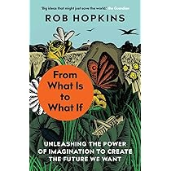
SOME SOURCES

Slide 32
Hope:
Refuse to accept the world as it is.
Find the levers for change. Anticipate and Evaluate the disruption you will cause.
Pull as appropriate.
Thanks for your time.

